Slide 1
LEAD SCORING Case Study – Assignment
LEAD SCORING
Dewang Satyam & Sriranjani S

Slide 2





AGENDA
Objective & Problem Statement
Goals & Approach
Data – Sourcing, Cleaning & Preparation
Data Analysis
Outliers
Preparation
Future Scaling / Splitting Train & Test Sets
Model Building
Model Evaluation
Sensitivity & Specificity (Train Set)
Precision & Recall (Test Set)
Sensitivity & Specificity (Test Set)
Result & Conclusion
Summary

Slide 3
OBJECTIVE
The purpose is to optimize the Lead scoring mechanism based on their fit, demographics, behaviours, buying tendency etc., by implementing explicit and implicit lead scoring modelling with lead point system
PROBLEM STATEMENT
An education company named X Education sells online courses to industry professionals. On any given day, many professionals who are interested in the courses land on their website and browse for courses.
The company markets its courses on several websites and search engines like Google. Once these people land on the website, they might browse the courses or fill up a form for the course or watch some videos. When these people fill up a form providing their email address or phone number, they are classified to be a lead. Moreover, the company also gets leads through past referrals. Once these leads are acquired, employees from the sales team start making calls, writing emails, etc. Through this process, some of the leads get converted while most do not. The typical lead conversion rate at X education is around 30%.
Now, although X Education gets a lot of leads, its lead conversion rate is very poor. For example, if, say, they acquire 100 leads in a day, only about 30 of them are converted. To make this process more efficient, the company wishes to identify the most potential leads, also known as ‘Hot Leads’. If they successfully identify this set of leads, the lead conversion rate should go up as the sales team will now be focusing more on communicating with the potential leads rather than making calls to everyone.

Slide 4
GOALS & APPROACH
GOAL
Build a logistic regression model to assign a lead score between 0 and 100 to each of the leads which can be used by the company to target potential leads.
A higher score would mean the lead is potential and conversion probability is high whereas a lower score would mean that it is not a potential one and conversion probability is low.
The model should be prepared in a way to adjust based on company’s requirement in future.
75%
APPROACH
100%
Data Sourcing
Data understanding
Data Cleaning
EDA
Feature Scaling
Data Splitting – Train & Test Dataset
Data preparation
Model building
Model evaluation – Specificity & Sensitivity / Precision recall
Prediction based on outcome
60%
50%

Slide 5




Data – Sourcing, Cleaning & Preparation
Read the data from CSV File
Outlier treatment
Data cleaning
Handling null values
Removing null value data
Removing unwanted columns in data
Imputing null values
Exploratory data analysis – Conversion ~ 38%
Feature Standardization

Slide 6
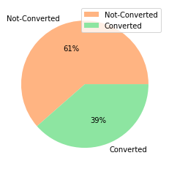
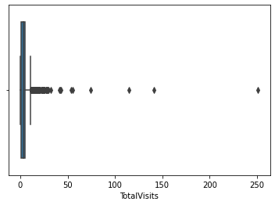
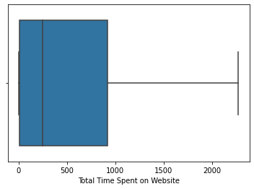
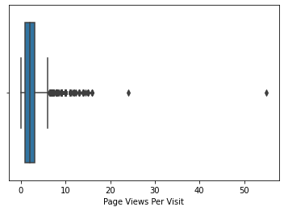
Data Analysis
Outliers
Non-Outliers
Parameters like Total Visits, Total time spent on website, page views per visit have outliers
PREPARATION
Convert variables to 0&1
Create dummy variables for categorical variables

Slide 7
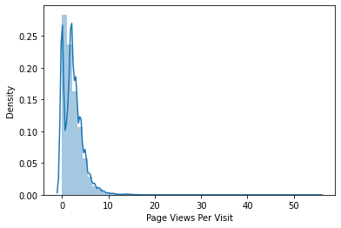
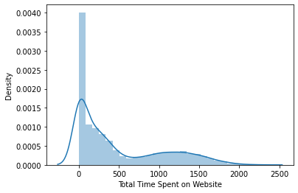
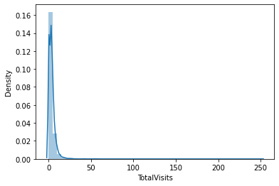
Feature Scaling / Splitting Train & Test Sets
Feature Scaling of Numeric Data
Splitting data into Train & Test Set

Slide 8
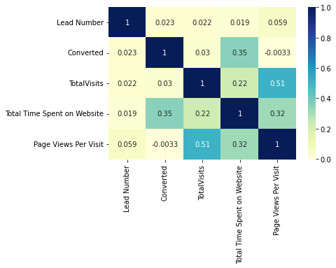
Model Building
Feature selection using RFE
Determined Optimal model using logistic regression
Calculated accuracy, sensitivity, specificity, prevision & Recall & evaluate model

Slide 9
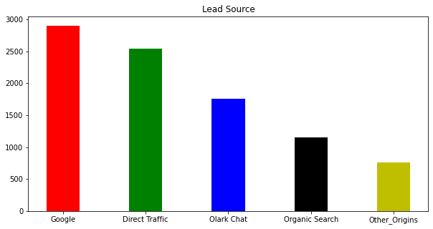
Model Building – Variables impacting conversion rates
1
Total visits
2
Total time spent on website
3
Lead Source_Olark chat
4
Lead origin_Lead Add Form
5
Lead Source_Welingak website
6
Do not email
7
Lead Source_Referral Sites.. etc.,

Slide 10
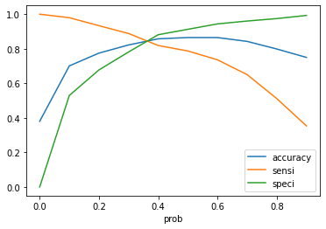
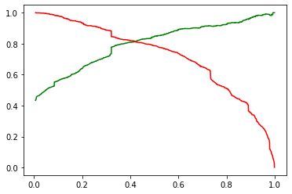
Model Evaluation
Sensitivity & Specificity – TRAIN DATA SET
Precision & Recall – TRAIN DATA SET
Sensitivity & Specificity – TRAIN DATA SET

Slide 11
Result
Conclusion
Accuracy, Sensitivity and Specificity values of training and test set are close to training set
Accuracy, Sensitivity and Specificity values of training set are 85%, 82%, 88% respectively
Accuracy, sensitivity& Specificity values of test are 82%, 81%, 80% respectively
Conversion rate for Train & Test Dataset is 82.7% & 80.8% respectively
We have done the prediction on the test set using cut off threshold from sensitivity & Specificity metrics
While we have checked both sensitivity-specificity as well as Precision & recall metrics, we have considered the optimal cut off based on sensitivity & specificity for calculating the final prediction
Accuracy, sensitivity & specificity values of test set are around 78%, 81%, 76% which are approximately closer to values calculated using Trained Data set
Lead score calculated for the conversion rate final model on Train & Test dataset is 82.7% & 80.8% respectively
Hence, Overall model seems to be GOOD

Slide 12
There are a lot of leads generated in the top stage but only a few of them come out as paying customers from the bottom
In the middle, we need to nurture the potential leads well in order to get a higher lead conversion
Sorting with best prospects from the leads generated. Total visits, Total time spent on Website, Page views per visit, will contribute towards probability of lead getting converted
Monitor each lead carefully and tailor the information according to the requirement.
Carefully provide job offerings, information or courses that suites best according to the interest of the leads.
A proper plan is to chart the needs of leads and approach with customized offerings.
Focus on converted leads.
Hold close connect with the leads to extract right information you need. Make further inquiries and appointments with the leads to determine their intention and to join online courses.
SUMMARY

Slide 13
Thank you
Dewang Satyam & Sriranjani S

